Slide 1
Course Title: Programming Language I
Course Code: CSE110
Semester: FALL 2022

Slide 2
Indentation
refers to the spaces at the beginning of a code line.
It indicates a block of code
The number of spaces is up to you as a programmer, but it has to be at least one.
A code block (body of a condition, loop, function etc) starts with indentation and ends with the first unintended line
Python will give you an error if you skip the indentation

Slide 3
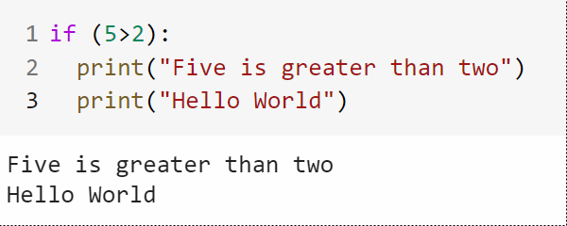
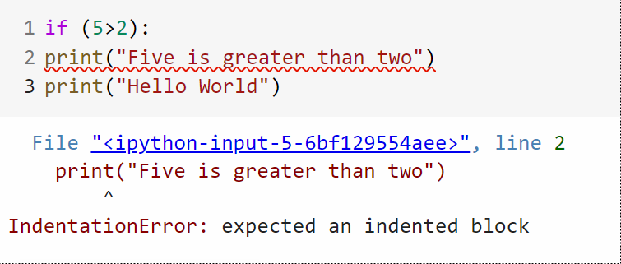
Indentation Example

Slide 4
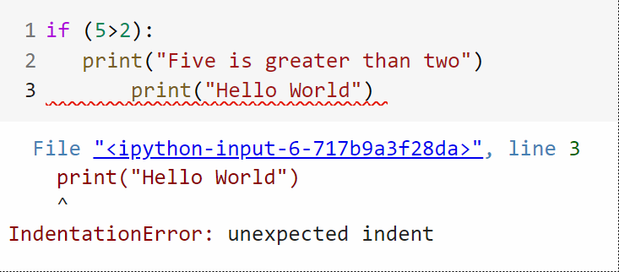
Indentation Example
You have to use the same number of spaces in the same block of code, otherwise Python will give you an error

Slide 5
Python Conditional Statements
Non sequential program statements
Code execution based on decisions
Decision making statements
if statement
if . . .else statements
if . . .elif statements
Nested if statements

Slide 6
if Statement
It is used to decide whether a certain statement or block of statements will be executed or not
If a certain condition is true then a block of statement is executed otherwise not.

Slide 7
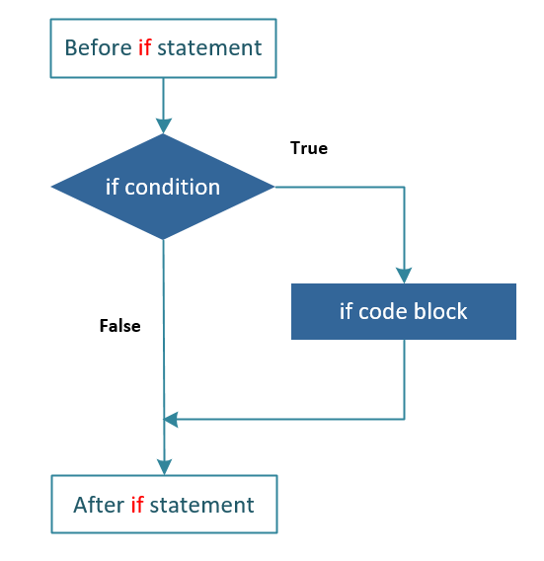
if Statement
Syntax
if test_expression1:
Body of if
if test_expression2:
Body of if
Rest of the codes
Example
if (it is sunny):
I’ll play cricket

Slide 8
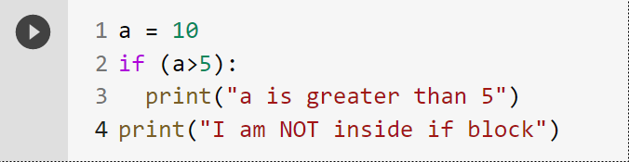
if Statement Example

Slide 9
if…else Statement
The else statement is always used with if statement.
It is used to execute block of codes whenever if condition gives false result.

Slide 10
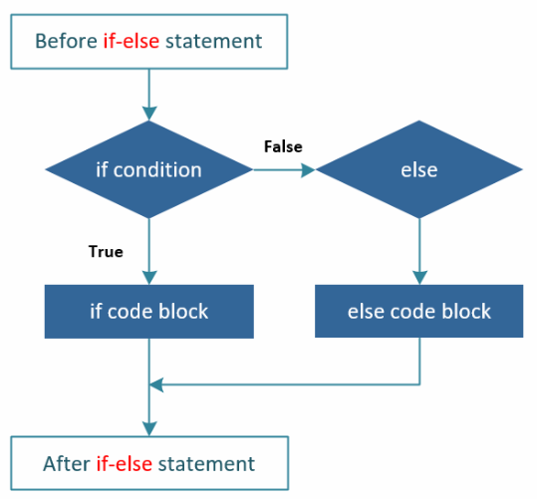
if…else Statement
Syntax
if test_expression1:
Body of if
else:
Body of else
Rest of the codes. . .
Example
if (it is sunny):
I’ll play cricket
else:
I’ll play indoors

Slide 11
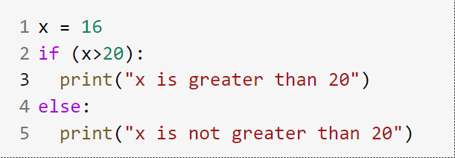
if…else Statement Example

Slide 12
if…elif…else Statement
For adding more conditions, elif statement in used. The program first checks if condition. When found false, it checks elif conditions. If all elif conditions are found false, then else code block is executed.

Slide 13
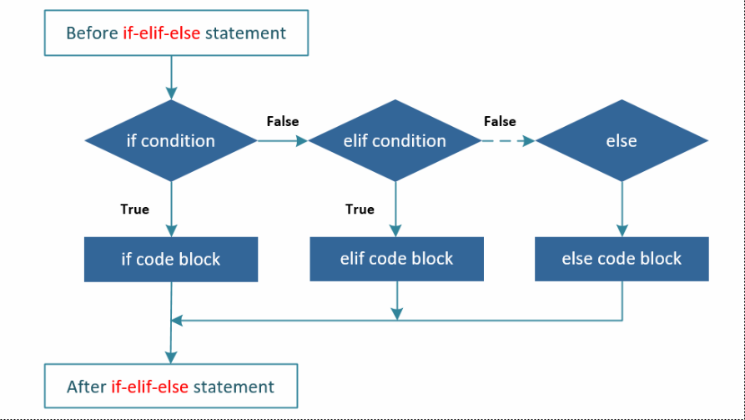
if…elif…else Statement
Syntax
if test_expression1:
Body of if
elif test_expression2:
Body of elif
elif test_expression3:
Body of elif
else:
Body of else
Rest of the codes. . .

Slide 14
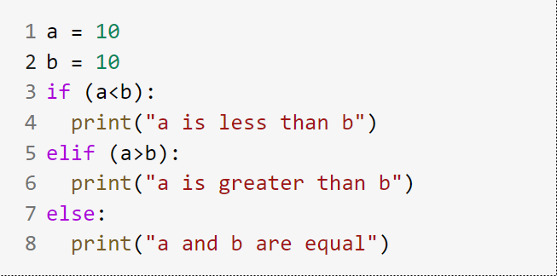
if…elif…else Statement Example

Slide 15
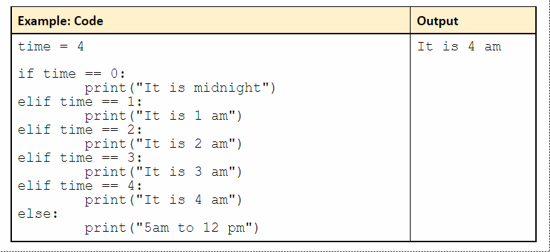
if…elif…else Statement Example

Slide 16
Nested if Statement
A nested if statement is an if statement placed inside another if statement.
In a nested if construct, you can have an if...elif...else construct inside another if...elif...else construct.

Slide 17
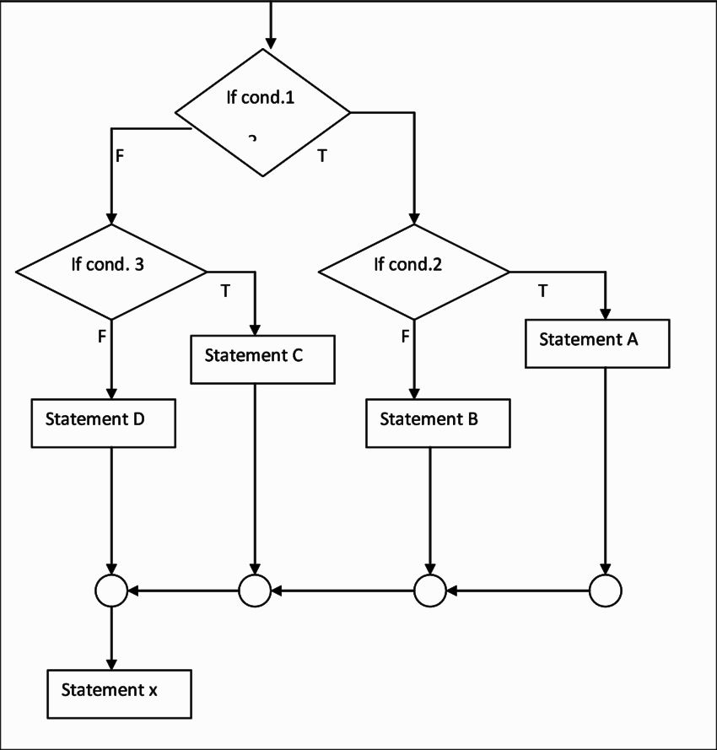
Nested if Statement

Slide 18
Nested if Statement
Syntax
if test_expression1:
if test_expression2:
Body of nested_if
else:
Body of nested_else
else:
Body of else
Rest of the codes. . .

Slide 19
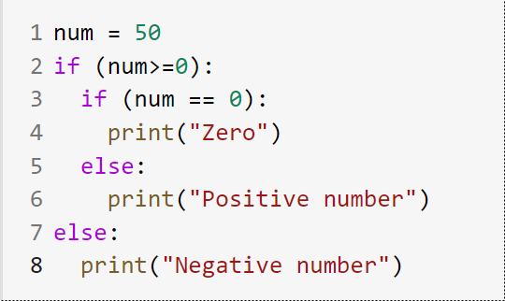
Nested if Statement Example

Slide 20
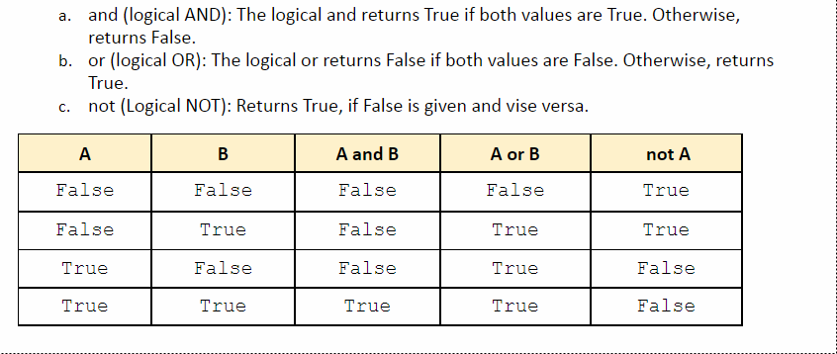
Logical Operators

Slide 21
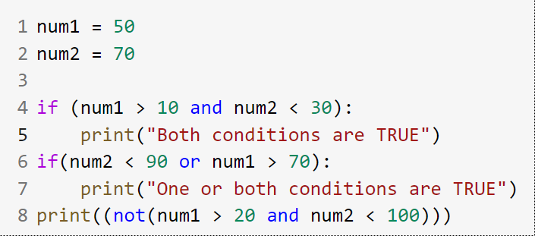
Logical Operators Example

Slide 22
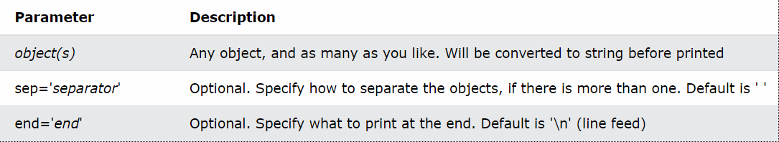
print() function
Syntax:
print(object(s), sep=separator, end=end, file=file, flush=flush)

Slide 23
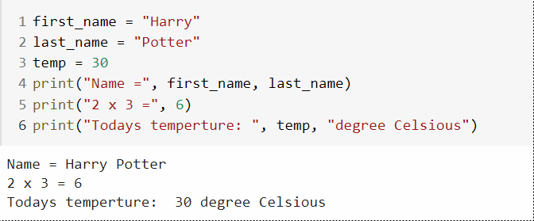
print() Function Example

Slide 24
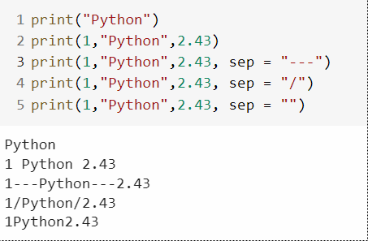
Keyword Argument sep
Adding the keyword argument sep = <str> causes objects to separated by the string <str> instead of the default single space
To squish objects together without any space between them specify sep = “”

Slide 25
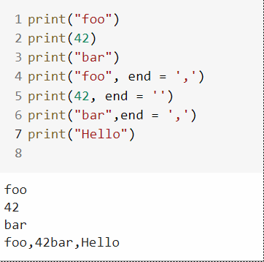
Keyword Argument end
The keyword argument end = <str> causes output to be terminated by <str> instead of the default newline

